Slide 1

The Evolution of Neologisms
Brooke Taylor
Mentors: Brendan Tracey and Vanessa Ferdinand
Summer 2017
Notes:
Worked/thanks with mentors Brendan and Vanessa

Slide 2
Outline
Introduction
What are neologisms?
Word2Vec
How the program works
The Corpus
Where the data comes from
Running Word2Vec
The process
Issues along the way
Results
Future Work
Variables to play with
Long-term questions
Graphical output

Slide 3
Introduction
Introduction
Word2Vec
The Corpus
Running Word2Vec
Results
Future Work

Slide 4
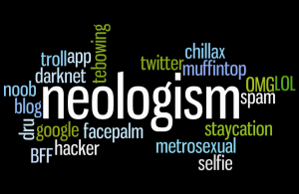
Neologisms?
Neologism: A newly coined word or expression
http://harryhurwitz.org/how-to-map-a-new-word/

Slide 5
How New Words Are Formed
Add/remove suffix or prefix (realize/realization)
Compounding (daydream)
Part of speech conversion (giant)
Eponyms (Kleenex)
Abbreviations (caravan/van)
Loanwords (tattoo)
Onomatopoeia (buzz)
Repetition or near-replication of word/sound (flip-flop)
Blending (sitcom)
Random (quark)
Error (doughnut/donut)
Notes:
****In this project we are not concerned on how the neologisms are formed, but on how they have changed after their formation

Slide 6
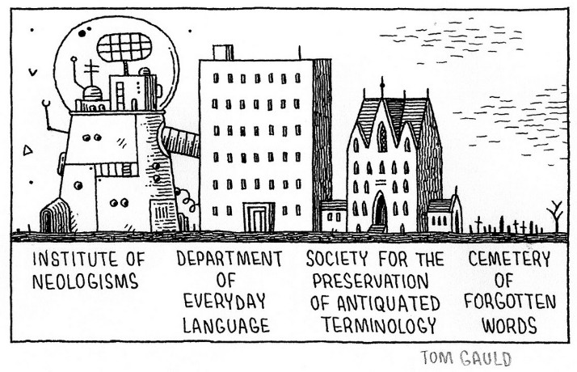
Neologisms in Language
https://stancarey.wordpress.com/2014/02/06/in-defence-of-unnecessary-words/
Notes:
Global Language Monitor:
In June 2009 the English language passed the 1 million word mark (currently about 1,005,000 words)
New word created every 98 minutes == 14.7 words per day == 5400 words per year
About only 1000 of these words are added to the dictionary per year
Cartoon shows a bit on why this might be
My focus is the in-between stage of first 2

Slide 7
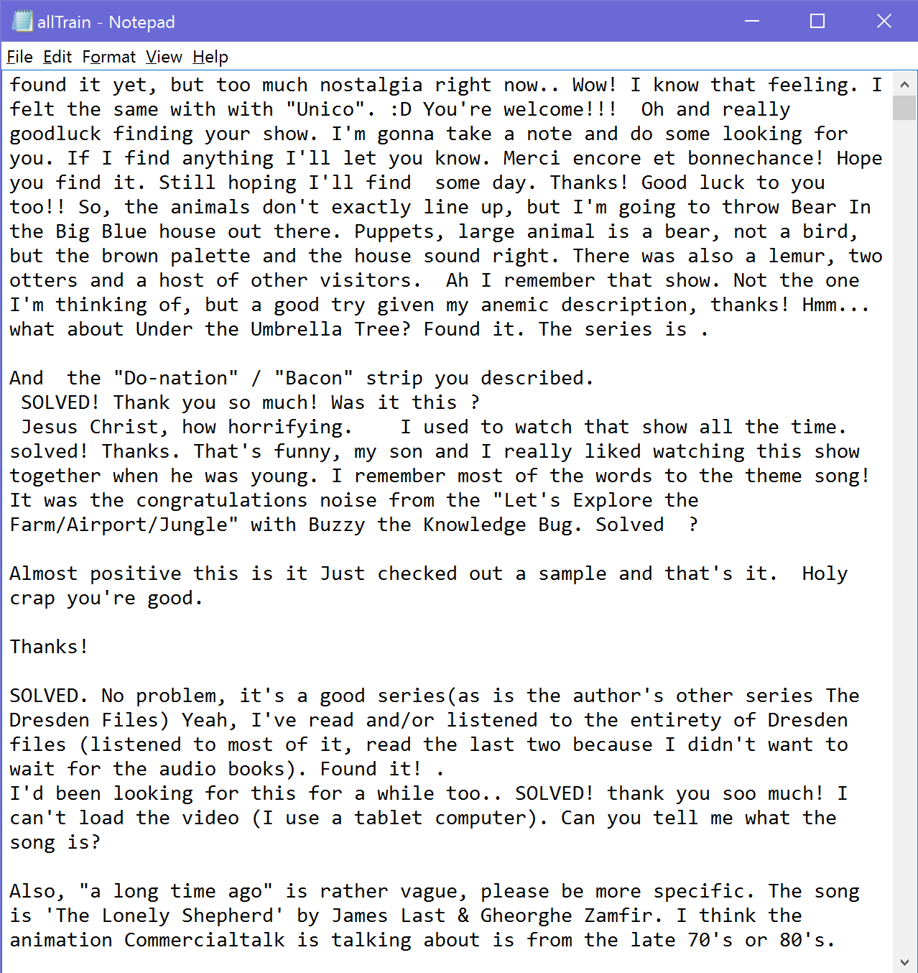
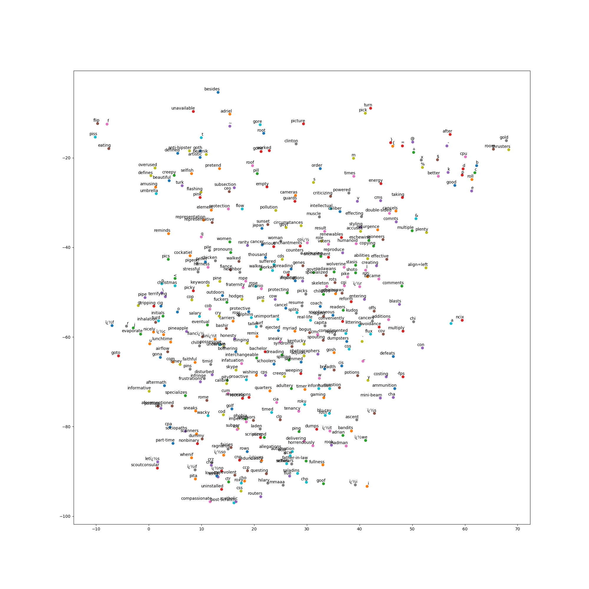
Measuring Word Evolution
Word2Vec
Notes:
***Introduced by Mikolov et al. in paper in 2013 and is commercially available from different sites
***100-dimensional space
Vectors are called “neural word embeddings”

Slide 8
Measuring Word Evolution
Notes:
Use is to stop treating words as individual units; use vectors to relate them to one another
Similar words (things/ideas) cluster together (e.g. oak, elm, birch)
This would give us a way to measure how these words changed both semantically and in sentiment over time

Slide 9
Word2Vec
Introduction
Word2Vec
The Corpus
Running Word2Vec
Results
Future Work

Slide 10
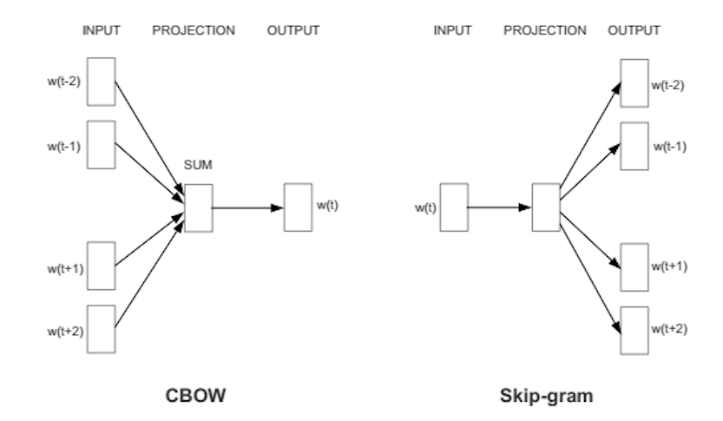
Word2Vec Models
Two training models:
Continuous bag of words (CBOW) – predict target words from context words
the quick brown fox jumps over the lazy dog
(context, target)
([the, brown], quick),
([quick, fox], brown),
([brown, jumps], fox),
…
(input, output)
([the, brown], quick),
([quick, fox], brown),
([brown, jumps], fox),
…
https://deeplearning4j.org/word2vec
Notes:
CBOW:
Predicts target words from source context words
Called this because order of words in the history does not affect the projection

Slide 11
Word2Vec Models
Two training models:
Skip-gram – predict context words from target words
the quick brown fox jumps over the lazy dog
(context, target)
([the, brown], quick),
([quick, fox], brown),
([brown, jumps], fox),
…
(input, output)
(quick, the), (quick, brown),
(brown, quick), (brown, fox),
(fox, brown), (fox, jumps),
…
https://deeplearning4j.org/word2vec
Notes:
Skip-gram:
Predicts source context words from target words
Weighs closer context words more heavily than further ones

Slide 12
Word2Vec Models
Two training models:
Continuous bag of words (CBOW)
Skip-gram
https://deeplearning4j.org/word2vec
Notes:
CBOW:
Treats entire context as one observation → Less memory → faster
Better at syntactic tasks (barely)
Skip-gram:
Treats each context-target pair as a new observation → more memory → slower
Therefore better for infrequent words
Better at semantic tasks

Slide 13
Word2Vec Models
Two training models:
Continuous bag of words (CBOW)
Skip-gram
https://deeplearning4j.org/word2vec

Slide 14
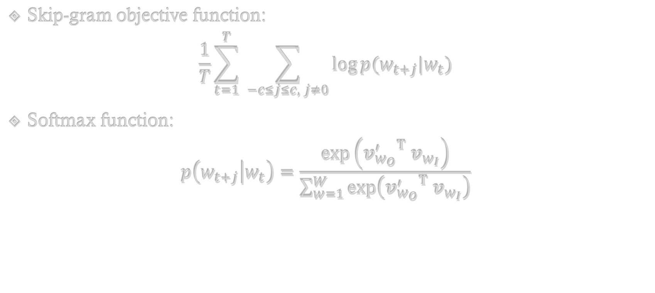
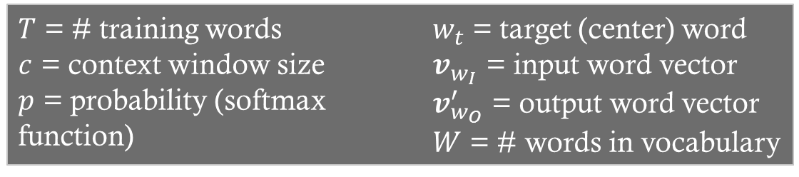
Skip-Gram Model
Skip-gram objective function:
$$\frac{1}{T}\sum_{t=1}^{T}{ \sum_{−c≤j≤c, j≠0}{\log{p(w_{t+j}|w_{t})}}}$$
Softmax function:
$$p\left(w_{t+j} | w_{t}\right)=\frac{\exp\left({{v_{w_{O}}^{′}}^{T} v}_{w_{I}}\right)}{\sum_{w=1}^{W}{\exp\left({{v_{w_{O}}^{′}}^{T} v}_{w_{I}}\right)}}$$
$T$ = # training words
$c$ = context window size
$p$ = probability (softmax function)
$w_{t}$ = target (center) word
$v_{w_{I}}$ = input word vector
$v_{w_{O}}^{′}$ = output word vector
$W$ = # words in vocabulary
Notes:
Given a sequence of T training words, the Skip-gram model’s objective is to maximize the average log probability of a context word given a target word
c is size of training context (words around target word)
probability is given by the softmax function
Softmax function works because words that are close together have a large transpose (dot product) == high probability; then normalized by dividing by probability of all pairs of words
Softmax function is computationally expensive because it requires calculating the sum over all pairs of words, and this does not work for large data sets
Researchers have used corpuses of 6 billion words; my data set is about 3.1 million words

Slide 15
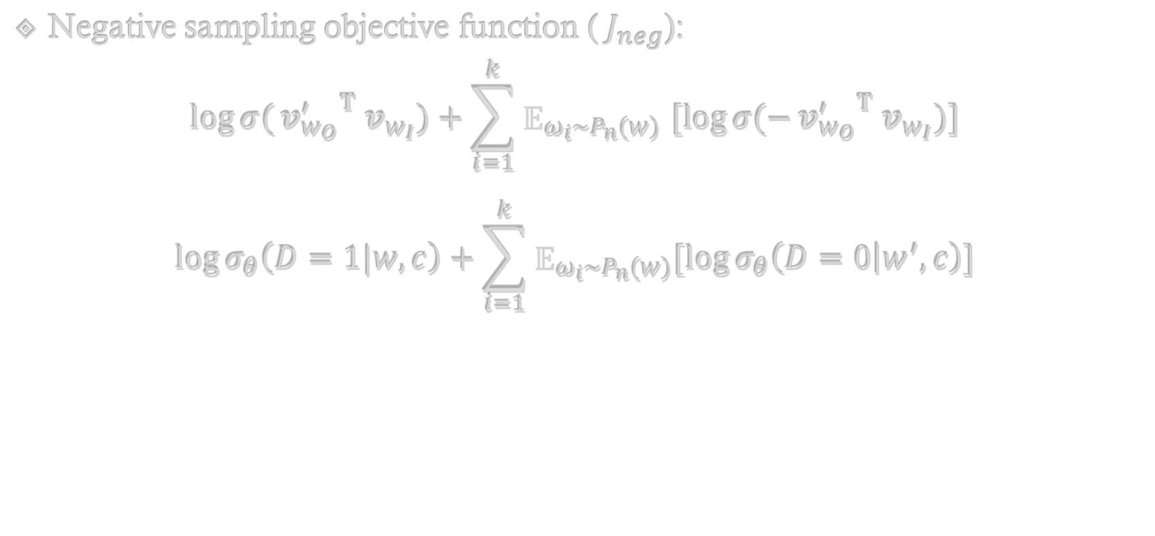
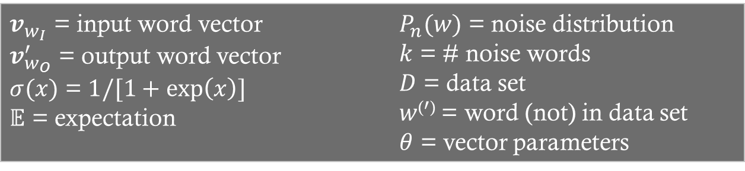
Skip-Gram Model
Negative sampling objective function (${ J}_{neg}$):
$$\log{σ(}{{v_{w_{O}}^{′}}^{T} v}_{w_{I}})+\sum_{i=1}^{k}{{\text{𝔼}}_{ω_{i}\sim P_{n}(w)} [\log{σ(−}{{v_{w_{O}}^{′}}^{T} v}_{w_{I}})]}$$
$$\log{σ_{θ}\left(D=1|w,c\right)}+\sum_{i=1}^{k}{{\text{𝔼}}_{ω_{i}\sim P_{n}(w)}[\log{σ_{θ}\left(D=0 | w^{′},c\right)}]}$$
$v_{w_{I}}$ = input word vector
$v_{w_{O}}^{′}$ = output word vector
$σ(x)$ = $1/[1+\exp\left(x\right)]$
$\text{𝔼}$ = expectation
$P_{n}(w)$ = noise distribution
$k$ = # noise words
$D$ = data set
$w$⁽$′$⁾ = word (not) in data set
$θ$ = vector parameters
Notes:
An approximation of the softmax function is negative sampling, replacing the logp term in skip-gram funct.
sigma is the logistic regression probability function
E is expectation (Monte Carlo average—samples mean of a function of simulated random variables)
→ target is to distinguish the target word from the noise distribution using logistic regression
→ assign high probabilities to real words and low probability to noise words
** Scales with the number of noise words rather than the number of words in the vocabulary
** Another way to write this is _____, where theta represents the parameters (embedding vectors), and D represents the dataset

Slide 16
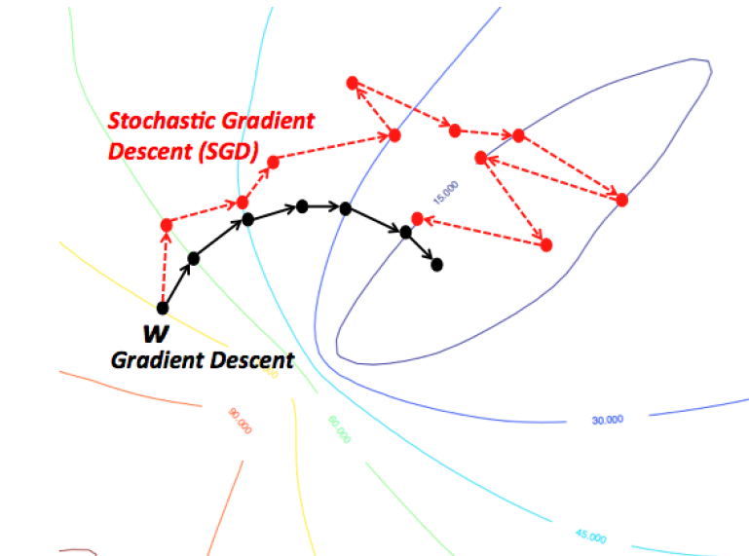
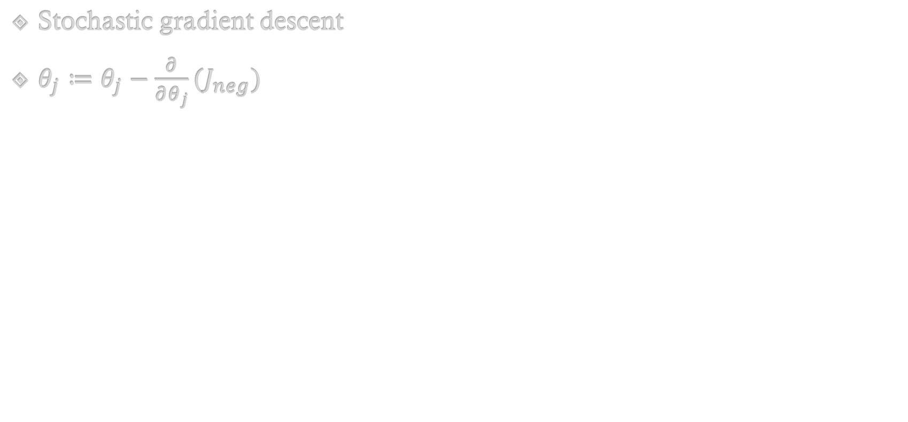
Skip-Gram Model Training
Stochastic gradient descent
$θ_{j}≔θ_{j}−\frac{∂}{∂θ_{j}}{(J}_{neg})$
(input, output)
(quick, the),
(quick, brown),
(brown, quick),
(brown, fox),
(fox, brown),
(fox, jumps),
…
Notes:
To change the parameters (theta) each time, the Skip-Gram Model trains using SGD
For a dataset of size D, normal gradient descent iterates over all of the words in D before changing theta; in SDG, it iterates over a batch of D before making a change
Means that it goes really close to the maximum, and close enough for this model

Slide 17
The Corpus
Introduction
Word2Vec
The Corpus
Running Word2Vec
Results
Future Work

Slide 18
Selected Neologisms
dab | yolo
ship | lightsaber
bromance | bae
photobomb | hipster
hangry | troll
Notes:
wanted neologisms that were popular enough to have a good amount of data on them over time frame 2011-2016
Variation of nouns, verbs, adjectives
Each has interesting characteristics:
Dab (marijuana-like drug), ship (romantic pairing), and troll (person who deliberately offends) have double meanings
Bromance and photobomb are two culturally popular things
Yolo is an abbreviation but treated/said as a word
Lightsaber and hipster (trendy, progressive in unconventional way) are perhaps no longer neologisms, but were in recent years, and wanted to see how they changed in our time frame

Slide 19
Selected Neologisms
dab | yolo
ship | lightsaber
bromance | bae
photobomb | hipster
hangry | troll
Notes:
These two are not really neologisms anymore, but were in recent history—wanted to study how they changed in our time frame

Slide 20

Corpus Source
Corpus requirements:
Documentation to access contents
Has a lot of content
Content contains neologisms
Answer: Reddit
The Python Reddit API Wrapper (PRAW)
https://www.reddit.com/
Notes:
Corpus requirements:
Had documentation to access contents
Had a lot of content
Had content that contained neologisms at high enough frequency

Slide 21
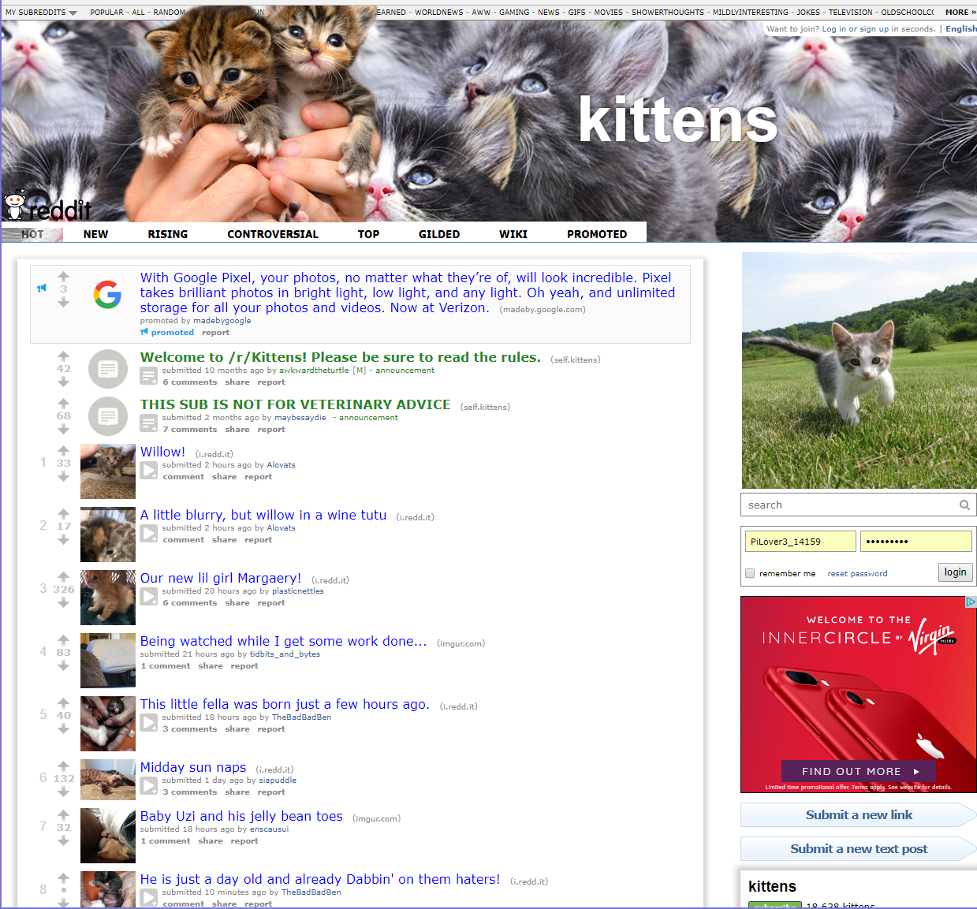
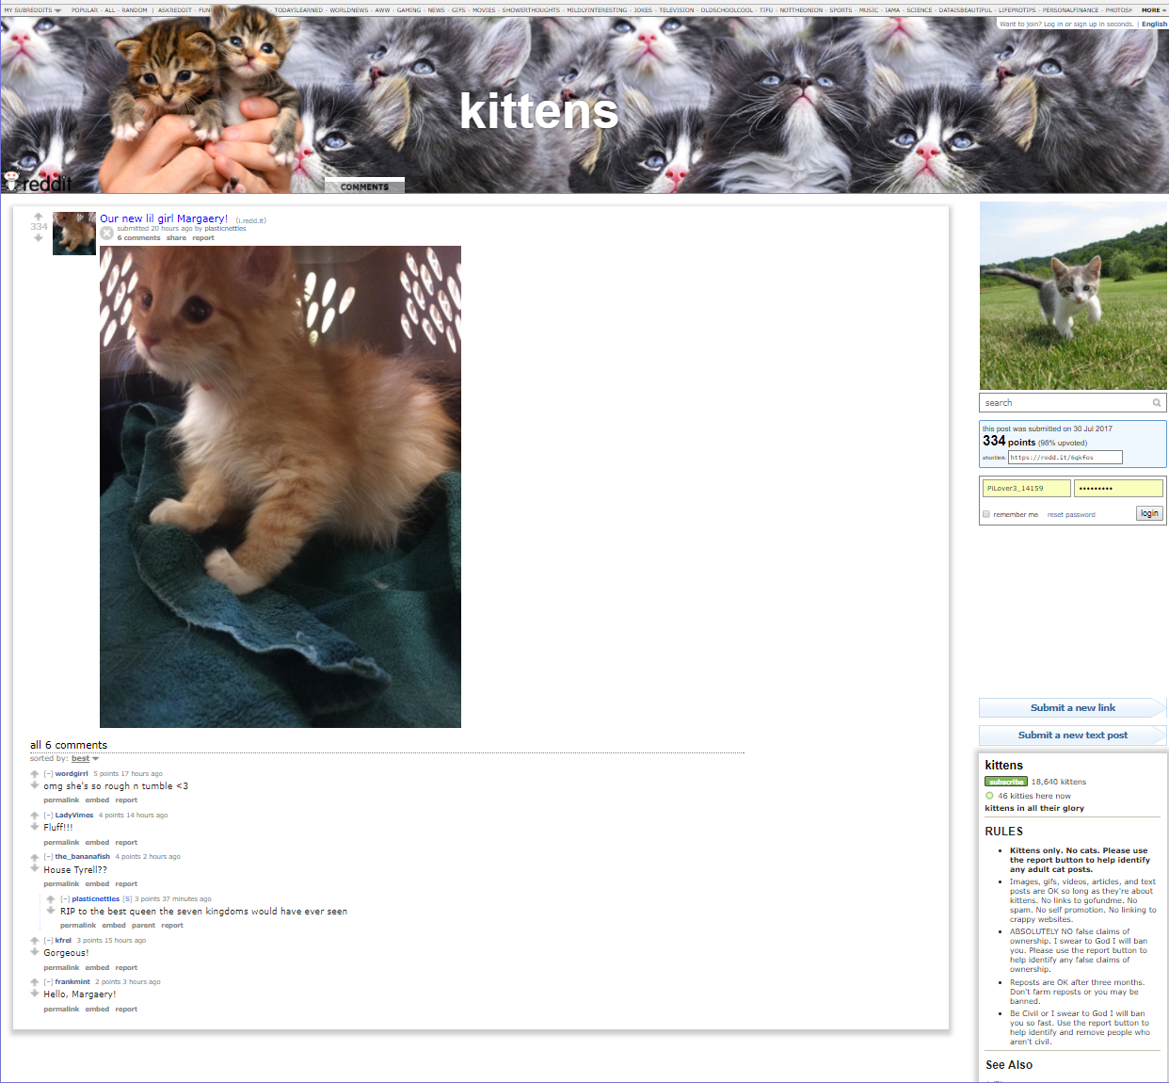
Layers of Reddit
Reddit
Subreddit
Submission
comments
https://www.reddit.com/
https://www.reddit.com/r/kittens/comments/6qkfos/our_new_lil_girl_margaery/
https://www.reddit.com/r/kittens/
Notes:
Reddit is a message board
Search for neologism in time frame
Iterate through all the subreddits the search returned, then iterate through each submission in each subreddit and collect all comments that contained the neologism in its contents

Slide 22
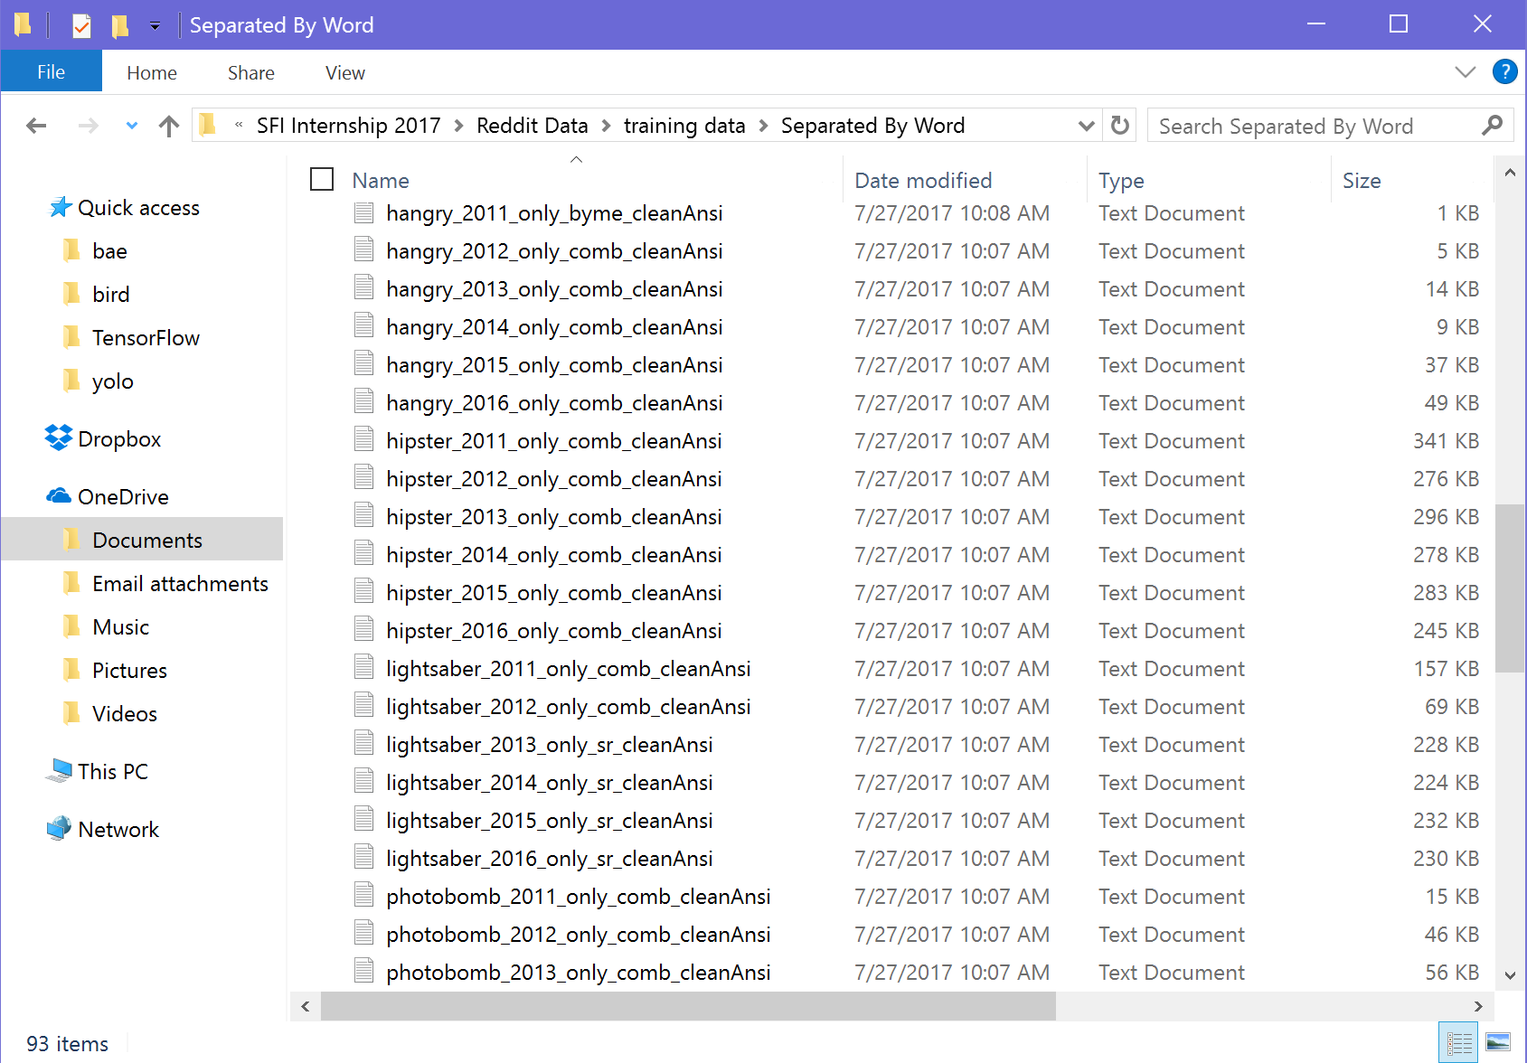
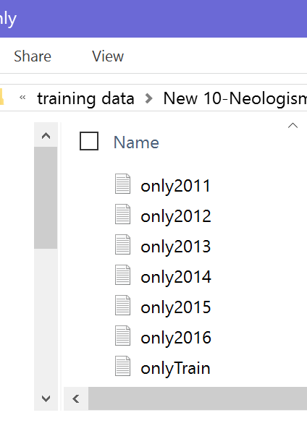
Collected Files
Notes:
Did this for each neologism over each year
Then combined each neologism for the same year into one file—this was the file W2V trained on

Slide 23
Running Word2Vec
Introduction
Word2Vec
The Corpus
Running Word2Vec
Results
Future Work

Slide 24
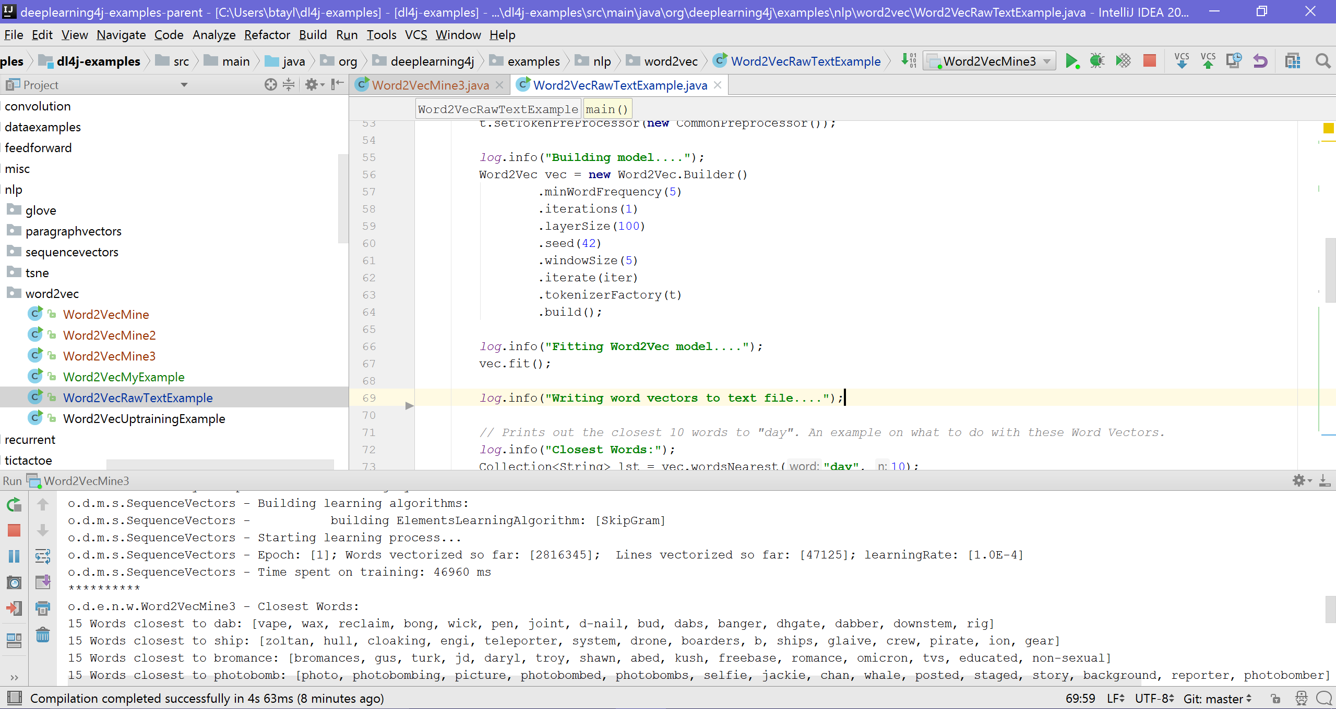
The Program
Notes:
Used DeepLearning4J’s program

Slide 25
The Output
Notes:
Outputs all words in corpus that occurred more than 5 times into 100-dimensional vector space
Again, point is that similar words are close in vector space—thus you can ask it what the 15 “closest” words are

Slide 26
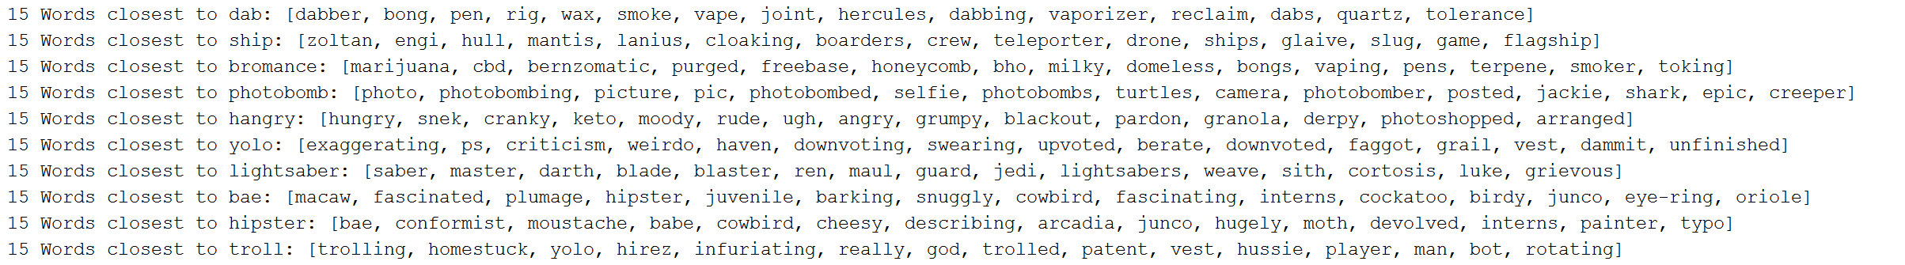
The Inquiry
hangry: hungry, snek, cranky, keto, moody, rude, ugh, angry, grumpy,
blackout, pardon, granola, derpy, photoshopped, arranged
Notes:
One thing you can ask W2V is the closest words to one word
Original hope to measure change of neologisms was based on how the R.W. changed
THIS IS IT—OUR DATA!

Slide 27
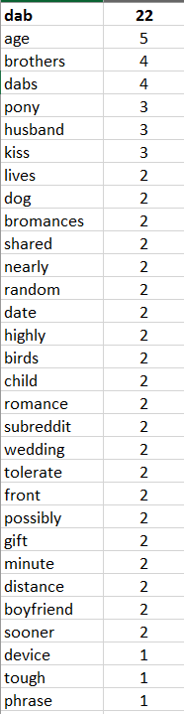
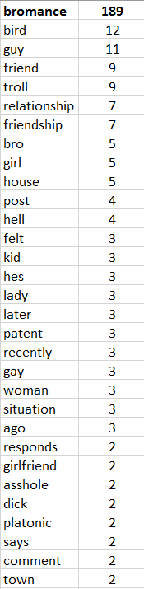
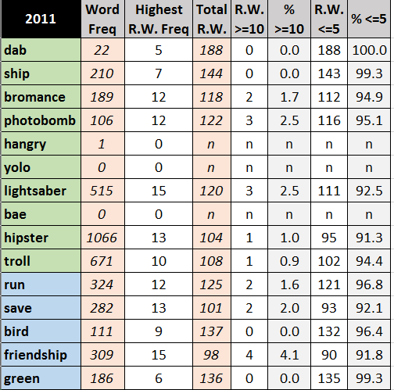
Word2Vec Issues
Notes:
Ran 15 times on exact same file (say 2011)
Absolute best: 15 words show up 15 times; absolute worst: W2V is completely random and 225 words show up once
Suggests instability in vector space
Belief is due to the low frequency of words

Slide 28
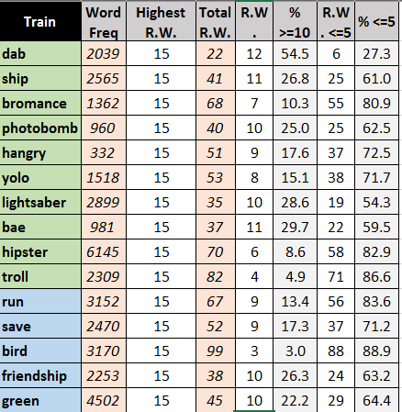
Word2Vec Issues
Notes:
Basically this meant that I could not just use the 15 closest word output to see how a word changed semantically/sentimentally over time
Not enough data?
Not the right data?
Bad W2V setup?
Simply a bad approach?
With the short time I had left, I brainstormed with Brendan and Artemy and kept the data we had and used a different measurement instead

Slide 29
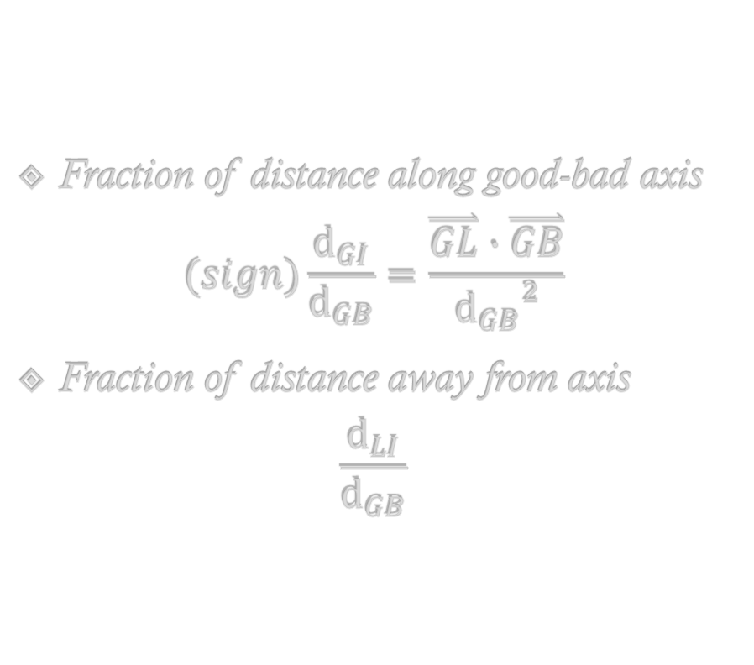
Measuring Axis Stability
bad (B)
Fraction of distance along good-bad axis
$$(sign)\frac{d_{GI}}{d_{GB}}=\frac{\overset{⃑}{GL}∙\overset{⃑}{GB}}{{d_{GB}}^{2}}$$
Fraction of distance away from axis
$$\frac{d_{LI}}{d_{GB}}$$
lightsaber (L)
intersection
(I)
good (G)
Notes:
Origin is white dot
Fraction 1 = GL dotted with GE/|GE| (unit vector) to get projection down onto axis, then divided by |GE| again
Idea is to get an idea of the sentiment or semantics of each neologism with respect to an axis that should be steady over time

Slide 30
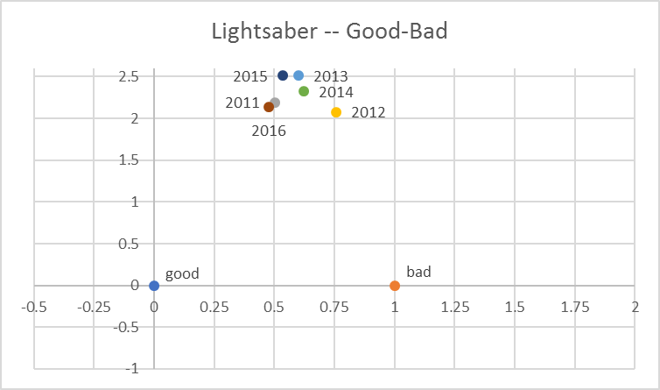
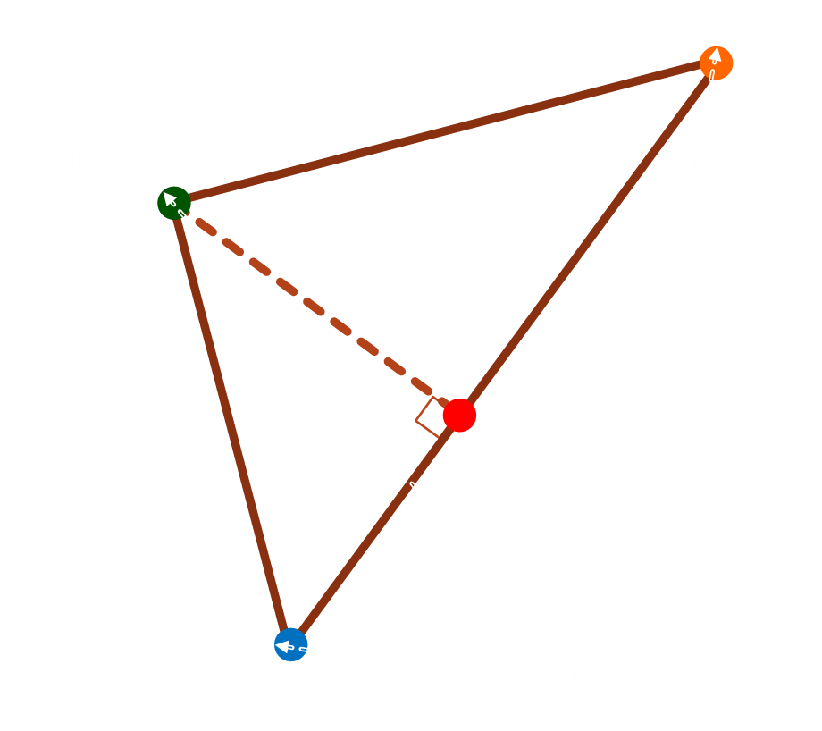
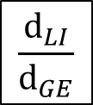

Graphical Output
$$\frac{d_{LI}}{d_{GE}}$$
$$\frac{\overset{⃑}{GL}∙\overset{⃑}{GE}}{{d_{GE}}^{2}}$$
Notes:
Each dot represents lightsaber at each different year
What quantifies “far”? Perhaps 1.5-2 (same distance as water, because, purple)
Same scale for all future plots

Slide 31
Selected Axes
good – bad
sad – happy
cool – lame
is – isn’t
new – old
unique axis
Notes:
All words are already in text file given originally—idea is that these axes are stable over time frame
first 3 axes for sentiment purposes and gauge people’s feelings on the words
is-isn’t to indicate if they may be negated of previous axes
new-old to see if people understand that these words are new or not
unique axis for each neologism to delve a little more deeply into each neologism

Slide 32
Results
Introduction
Word2Vec
The Corpus
Running Word2Vec
Results
Future Work
Notes:
Lots of perspectives to see in each of the plots, I will just highlight a few of them

Slide 33
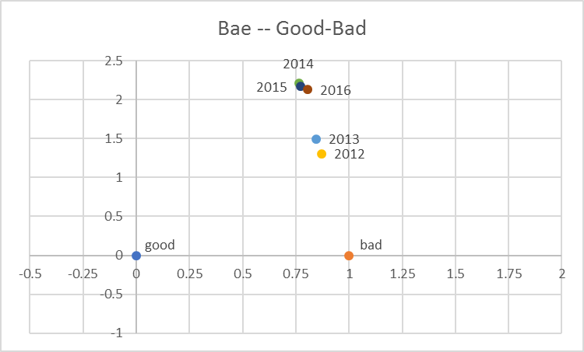
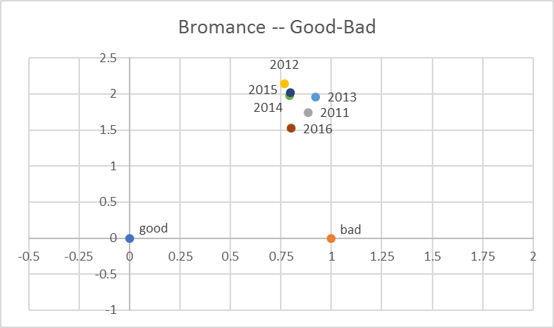
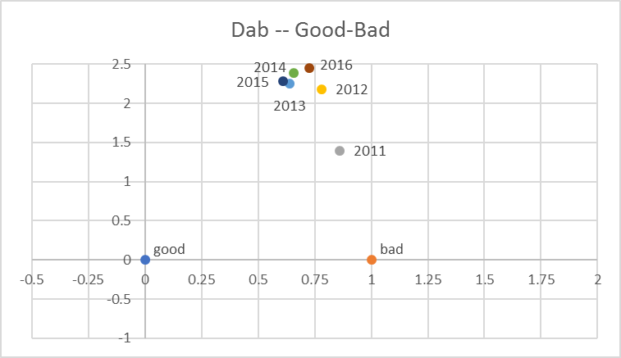
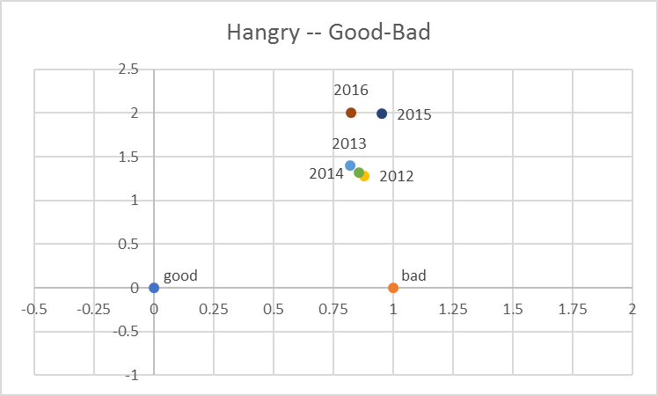
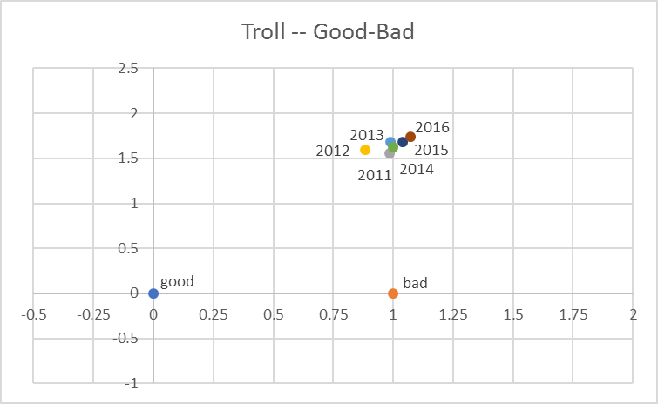
Good-Bad Axis
Notes:
good-bad axis is not the most ideal axis to compare neologisms to, as all are probably insignificantly far away

Slide 34
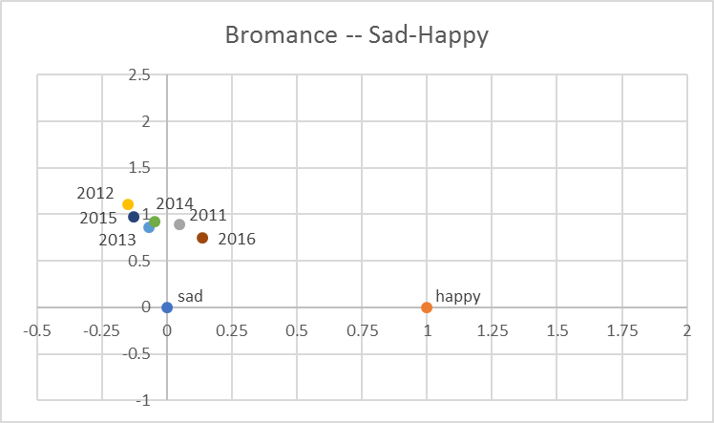
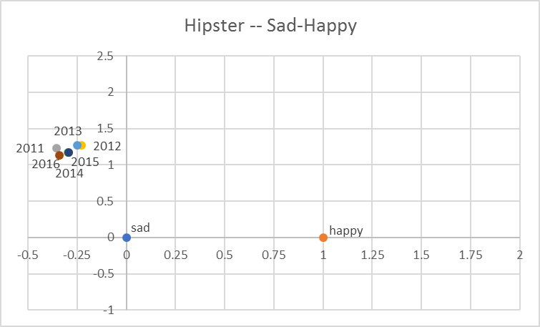
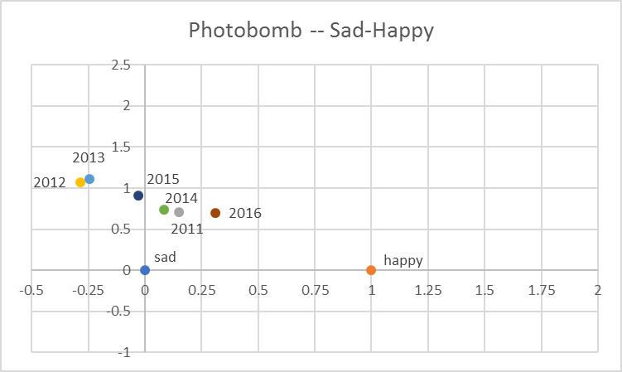
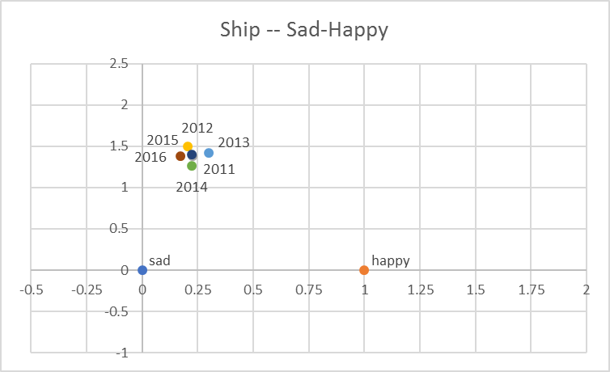
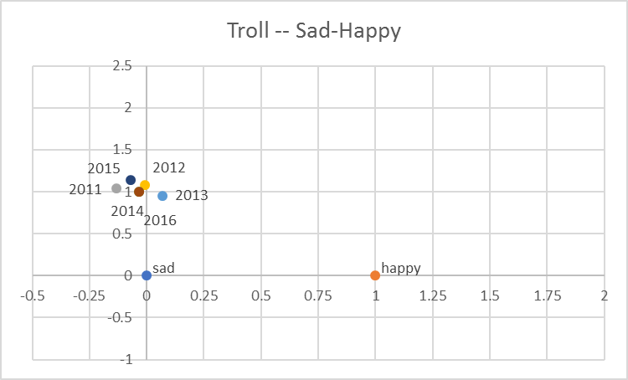
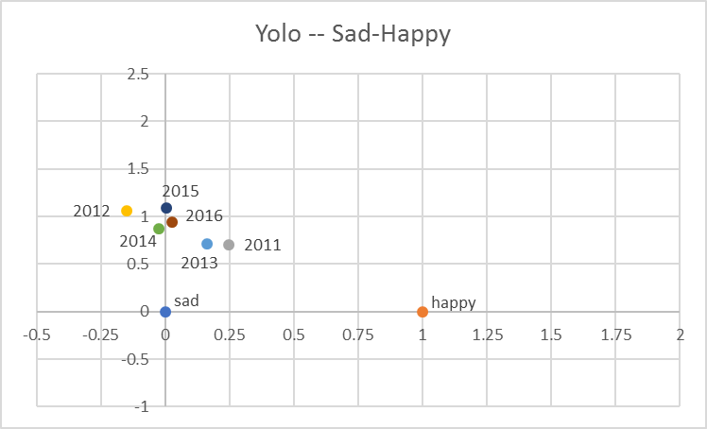
Sad-Happy Axis
Notes:
Words now much lower on y-axis

Slide 35
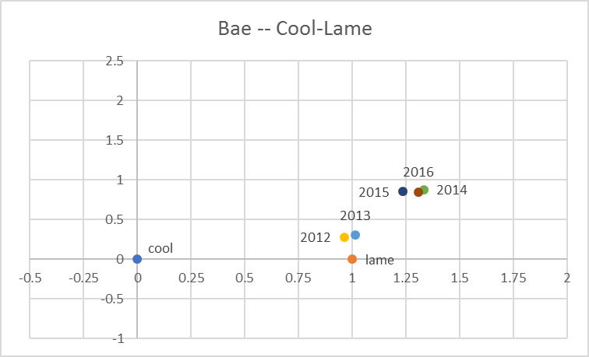
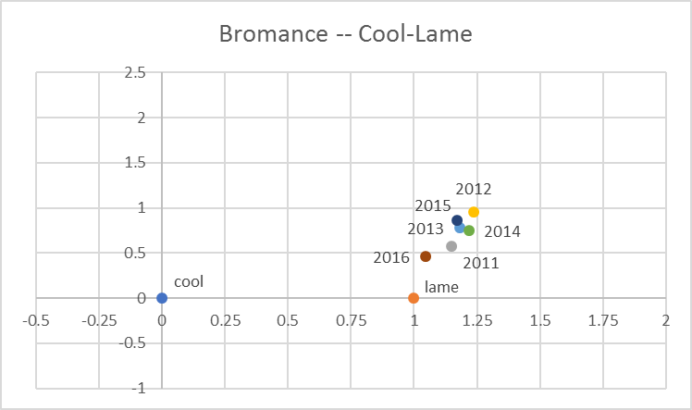
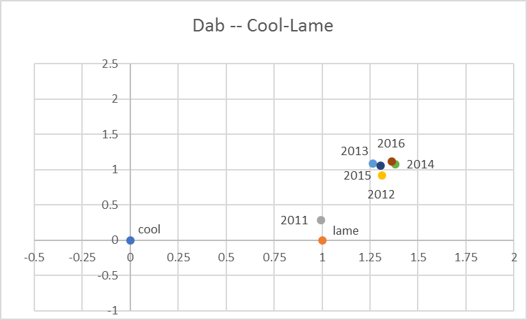
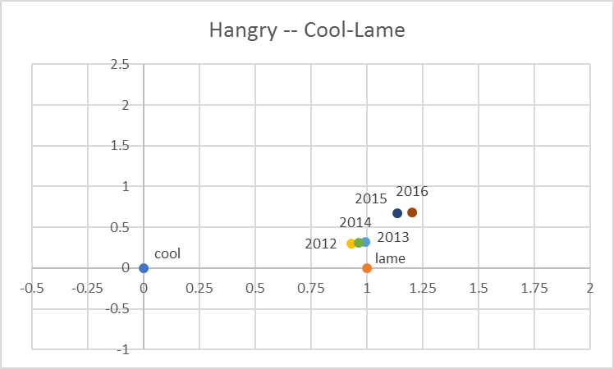
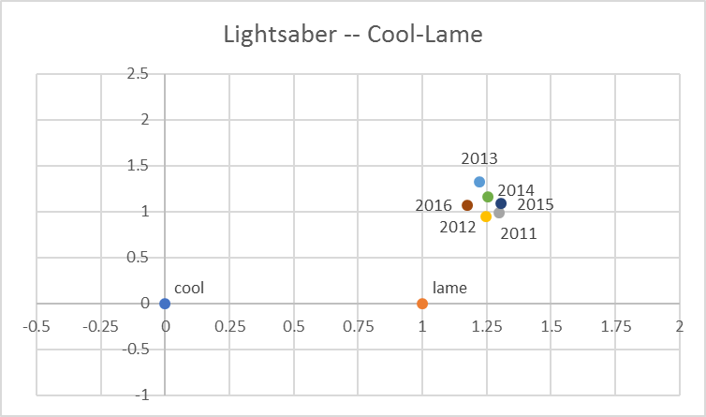
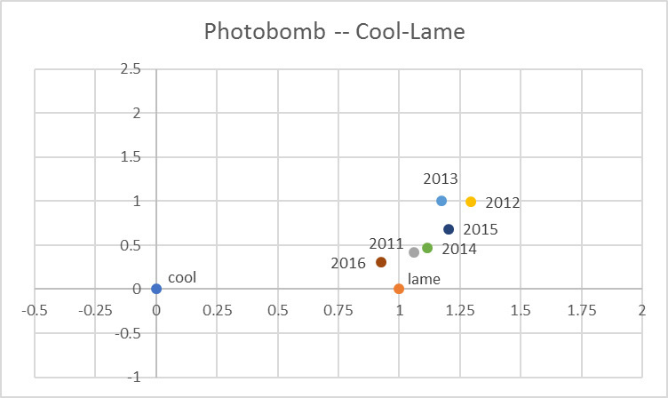
Cool-Lame Axis

Slide 36
Neologisms Are Sad and Lame
Notes:
Not sure if these are indicitave of language or just a result of our data as is

Slide 37
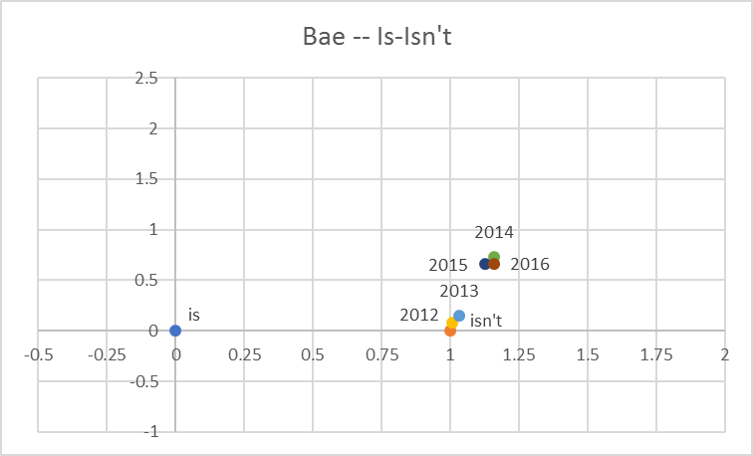
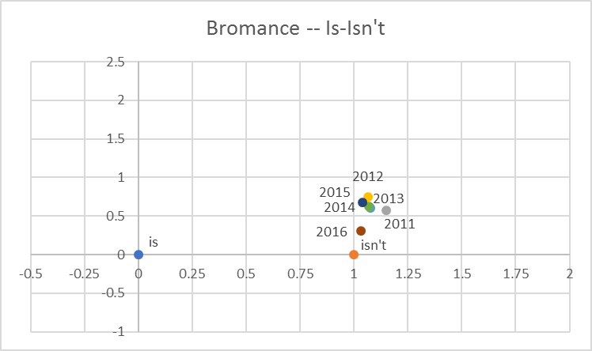
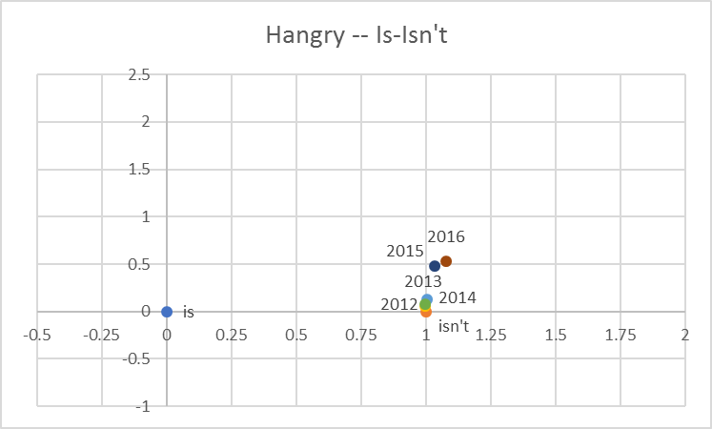
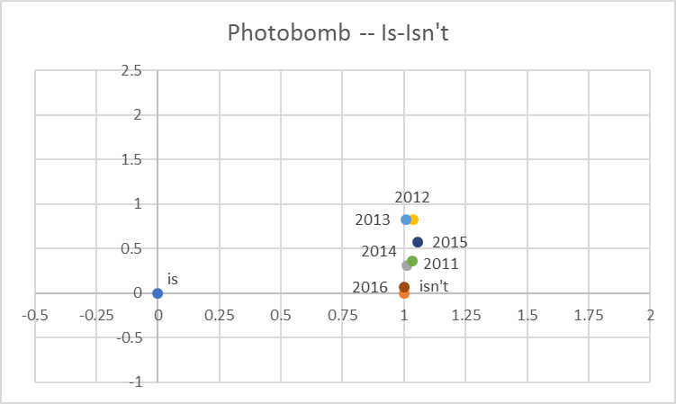
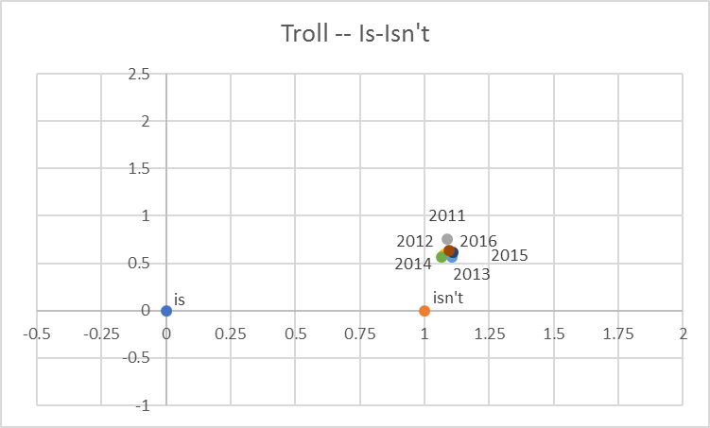
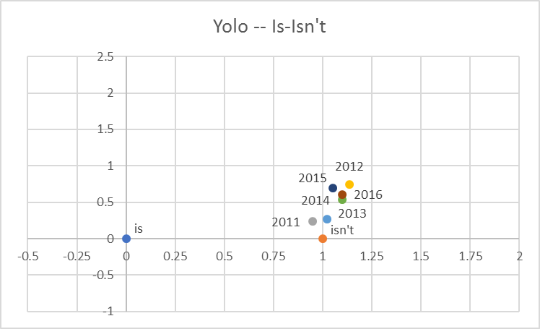
Is-Isn’t Axis

Slide 38
Neologisms Are NOT Sad and Lame
?
Notes:
Not entirely sure what conclusion to draw from this—would need more time
Looking at insights we COULD gain since we’re not certain about how much to trust the output
Why we do not know exactly why these results are the way they are, the hope with these plots is to give us a better idea of what questions we should be asking
Shows us some axes are better measures of sentiment than others (good-bad vs sad-happy)
With the right axis shows that we can get a good gauge on sentiment of a word

Slide 39
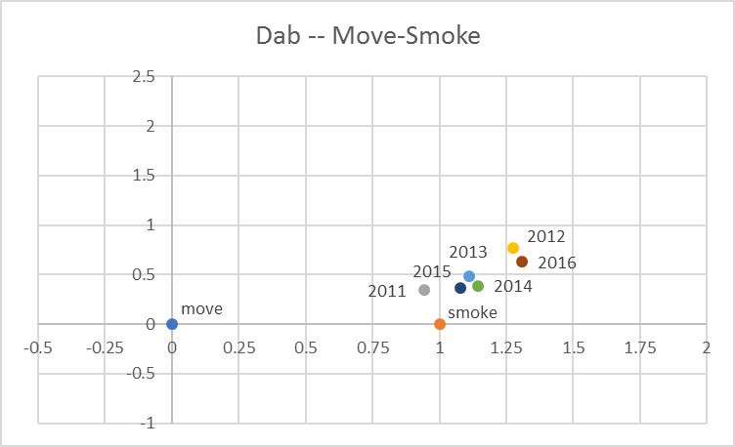
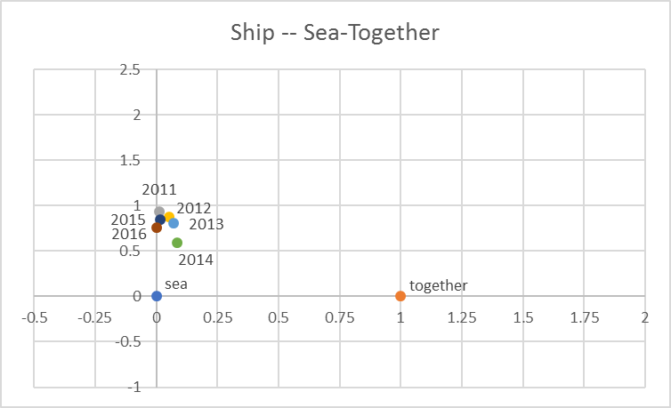

Unique Axes 1
Notes:
Vectors help give a semantic definition
These three words are more closely associated with their non-neologism definition

Slide 40

Unique Axes 2
Notes:
Another example of semantics, since hipsters tend to be young rather than old people

Slide 41

Unique Axes 3
Notes:
Interesting result where we would expect exact middle but instead get only hungry
Probably because when we are hungry we can also be angry, but it is rare that when we are angry it is because we are hungry

Slide 42

Unique Axes 4
Notes:
Jumps around a lot
Perhaps announcement of new Star Wars in 2015 changed general talk of lightsabers (more likely to associate with jedi) to speaking of the sith again

Slide 43

Unique Axes 5
Notes:
YOLO = you only live once → might expect to be close to life, but in fact is just as close to death
Gives idea of context—use yolo when talking about things to do before death

Slide 44

Unique Axes 6
Notes:
Trajectory over time—starts off annoying, then is funny, then back to annoying
Insight into people’s reactions to the practices that become popular

Slide 45







Neologisms vs. Commons 1
Notes:
Observe that neologisms seem to move around a bit more than more common words

Slide 46







Neologisms vs. Commons 2
Notes:
Observe that neologisms seem to move around a bit more than more common words
On cool-lame axis the common words are even more condensed

Slide 47
Future Work
Introduction
Word2Vec
The Corpus
Running Word2Vec
Results
Future Work

Slide 48
Other Variables and Ideas to Test
Other neologisms, other axes
Different corpus source
Bigger data sets
Longer time frames
Other ways to measure change?
Retry original approach from a different angle
Finding “velocity” of neologisms in Word2Vec space
Mathematically rigorous definition of how “much” change occurs in comparison to common words
Notes:
To continue on this line of thought, there are many other variables we could test to see how our results might change
Also this is only with respect to an axis—other ways to measure “change”

Slide 49
Ultimate Questions
How can we predict which neologisms remain in our language?
How can we use Word2Vec to predict when a new word is needed?
Why are popular words more negative? Were they always more negative?
What causes a word to change?
How fast does language evolve?

Slide 50
“
For last year’s words belong to last year’s language
And next year’s words await another voice.
”
T. S. Eliot, The Four Quartets
Notes:
Neologisms are being created and lost every day, and thus can give us a lot of insight into how our language is formed as a whole
***Thanks to SFI for opportunity

Slide 51
Acknowledgements
Brendan Tracey
Vanessa Ferdinand
Santa Fe Institute

